Slide 1
Università degli studi di Modena e Reggio Emilia
Dipartimento di Scienze della Vita
Corso di Laurea in Biotecnologie
INVESTIGATING THE CONTRIBUTION OF (EIGHT) ACTOMYOSIN REGULATORS TO THE SOMATIC VERSUS THE GERMLINE IN C. ELEGANS
Relatore
Prof. Davide Malagoli
Correlatori
Dr. Ana Xavier de Carvalho, Principal Investigator
Dr. Daniel Sampaio Osório, Junior researcher
Tesi di laurea di:
Maurizio Gilioli
Anno Accademico 2019/2020

Slide 2
Preface and aim of this project
A previous RNAi screening of 135 actomyosin related genes performed in Caenorhabditis elegans gonads had the aim of characterizing and clustering the resulting phenotypes. From this screening, RNAi of 8 genes resulted in a specific phenotype, i.e., the Emo-phenotype, characterized by the presence of endoreplicating oocytes with polyploid nuclei inside the gonads.
This project aimed to further analyze, through brood size experiments, the specific contribution of these genes in the germline or somatic lineages of the C. elegans gonad by using strains specifically sensitive to RNAi in the somatic (NL3511) or germline (DCL569) tissues.
Key words: Caenorhabditis elegans; Actomyosin, Emo-phenotype, Gonads

Slide 3
INTRODUCTION
C. elegans life cycle
Hermaphrodite gonads
Emo phenotype

Slide 4
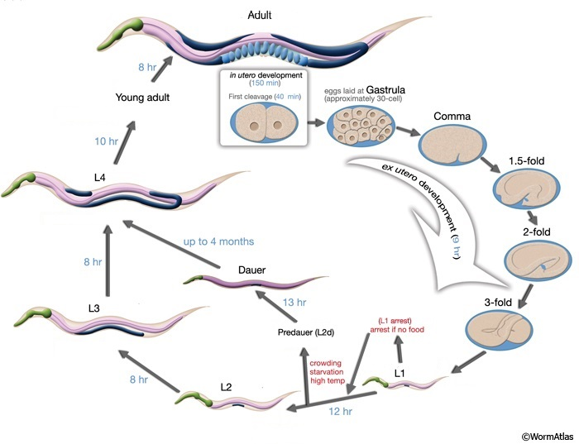
C. elegans life cycle
C. elegans exists primarily as a self-fertilizing hermaphrodite, although males arise at a frequency of <0.1 %.
C. elegans developmental cycle comprises an embryonic stage, four larval stages (L1 until L4), the young adult stage, and adulthood (steps).
It is possible to regulate the development speed through temperature. In optimal conditions, C. elegans develops completely in about 3.5 days at a temperature of 22 °C.
Adapted from Altun ZF, Hall DH. 2021. WormAtlas Hermaphrodite Handbook - Introduction to C. elegans anatomy. http://www.wormatlas.org/hermaphrodite/hermaphroditehomepage.htm.

Slide 5
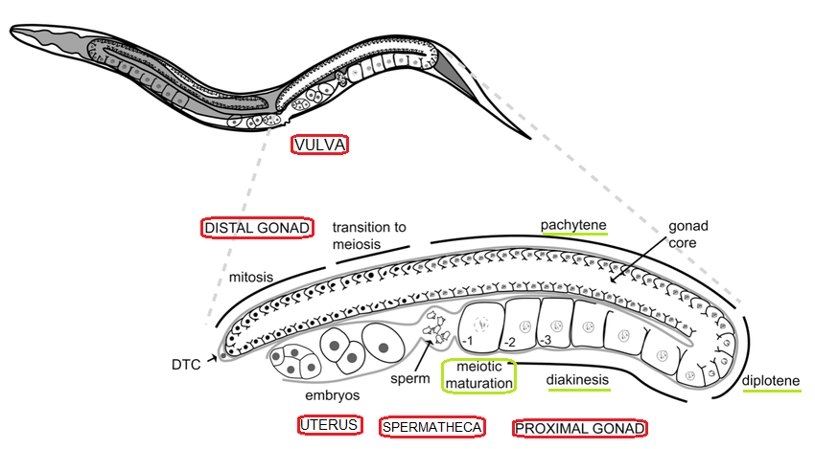
Hermaphrodite Gonad
Adapted from Huelgas-Morales G, Silva-García CG, Salinas LS, Greenstein D, Navarro RE. 2016. The Stress Granule RNA-Binding Protein TIAR-1 Protects Female Germ Cells from Heat Shock in Caenorhabditis elegans. G3 (Bethesda). 6(4):1031–1047. doi:10.1534/g3.115.026815.

Slide 6
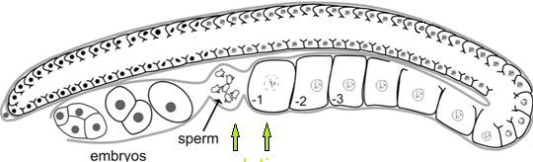
Emo Phenotype (endomitotic oocytes)
The Emo phenotype (endomitotic oocyte) takes place when ovulation and/or fertilization do not occur normally and, nevertheless, oocytes exit diakinesis of meiosis I and start endo-replicating their DNA, consequently gaining polyploid nuclei. The studied genes, orthologs of human genes, could be involved in the ovulation process and in other necessary for the correct development of the germline.
Ovulation, Fertilization
Adapted from Huelgas-Morales G, Silva-García CG, Salinas LS, Greenstein D, Navarro RE. 2016. The Stress Granule RNA-Binding Protein TIAR-1 Protects Female Germ Cells from Heat Shock in Caenorhabditis elegans. G3 (Bethesda). 6(4):1031–1047. doi:10.1534/g3.115.026815.
Gene | ani-1 | lev-11 | let-502 | mlc-4 | mlc-5 | par-6 | rho-1 | unc-45
Protein | Anillin-like protein 1 | Tropomyosin | Rho-associated protein kinase | Myosin regulatory light chain 4 | Myosin essential light chain 5 | Partitioning defective protein 6 | Ras-like GTP-binding protein | Myosin chaperone protein

Slide 7
METHODS

Slide 8

Strains of C. elegans used for BROOD SIZE counting experiments:
For the counting of the progenies, these strains were used:
N2 strain was used to target both the components of the gonads
NL3511 strain was used to target through RNAi the somatic cells, comprised the somatic gonad
DCL569 strain was used to target through RNAi specifically the germline

Slide 9
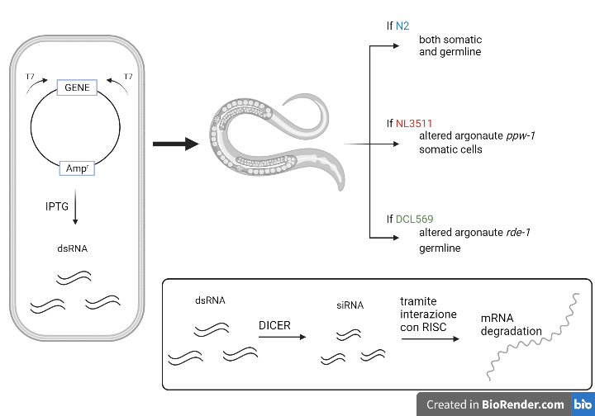
RNA interference
Created with BioRender.com

Slide 10
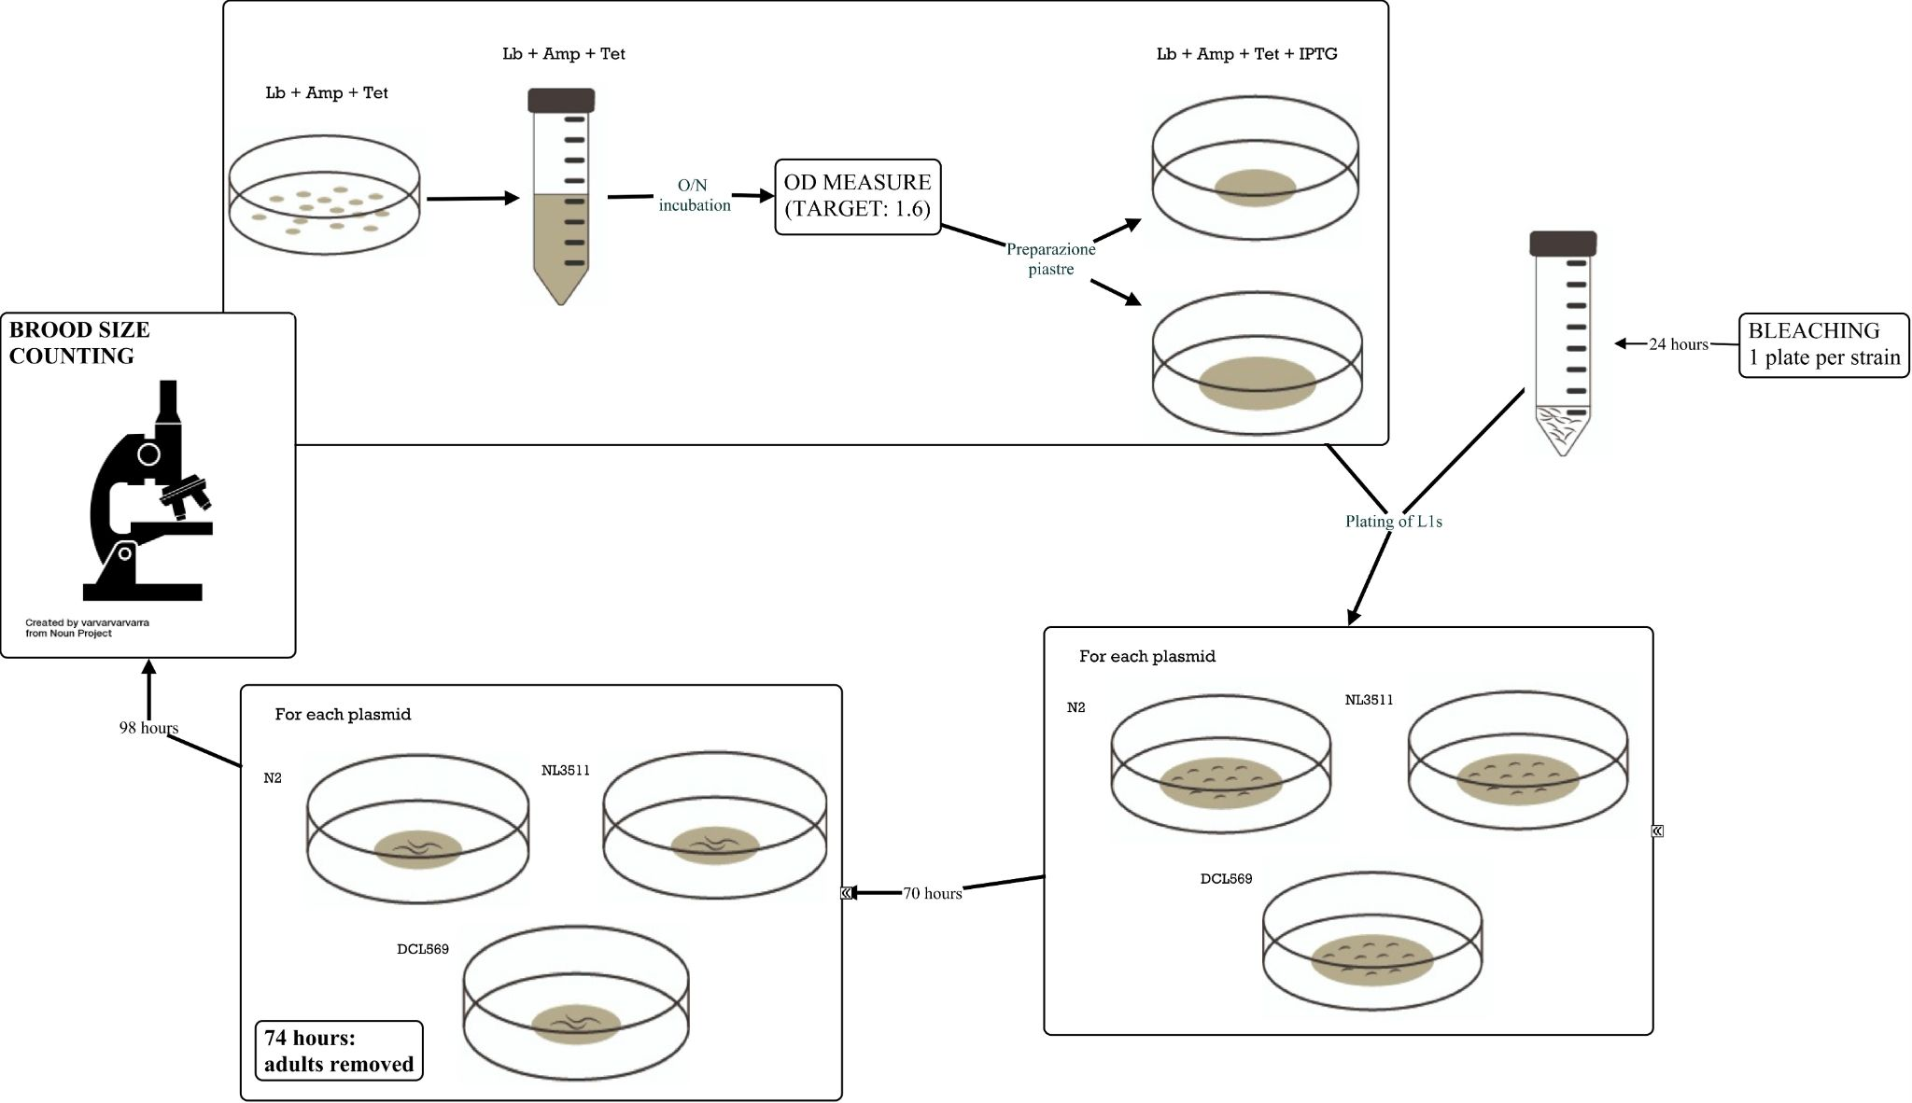

Slide 11
RISULTATI
Controlli (empty vector, myo-3, wee-1.3)
ani-1, lev-11,mlc-4,, rho-1, unc-45
let-502, mlc-5, par-6

Slide 12
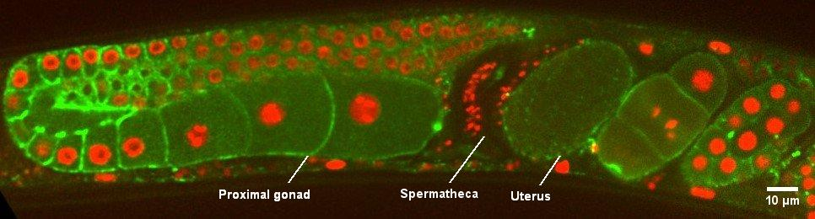
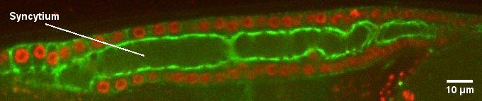
Negative Control - Empty vector
NMY-2::GFP
H2B::mCherry
Description: Gonad of a GCP812 animal after 71 hours of animal feeding with bacteria expressing dsRNA from the empty L4440 vector, which resulted in animals with a wild-type gonad

Slide 13
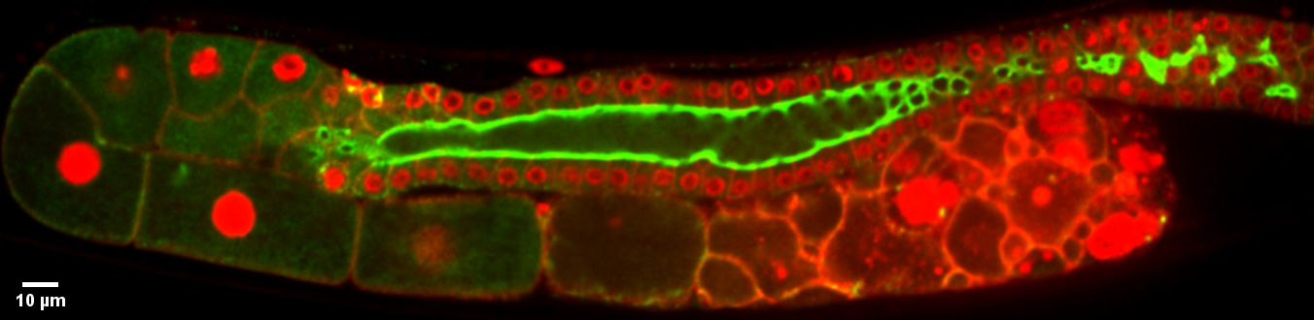
Positive Controls: wee-1.3
Positive Controls: myo-3
NMY-2::GFP
mCherry::H2B

Slide 14
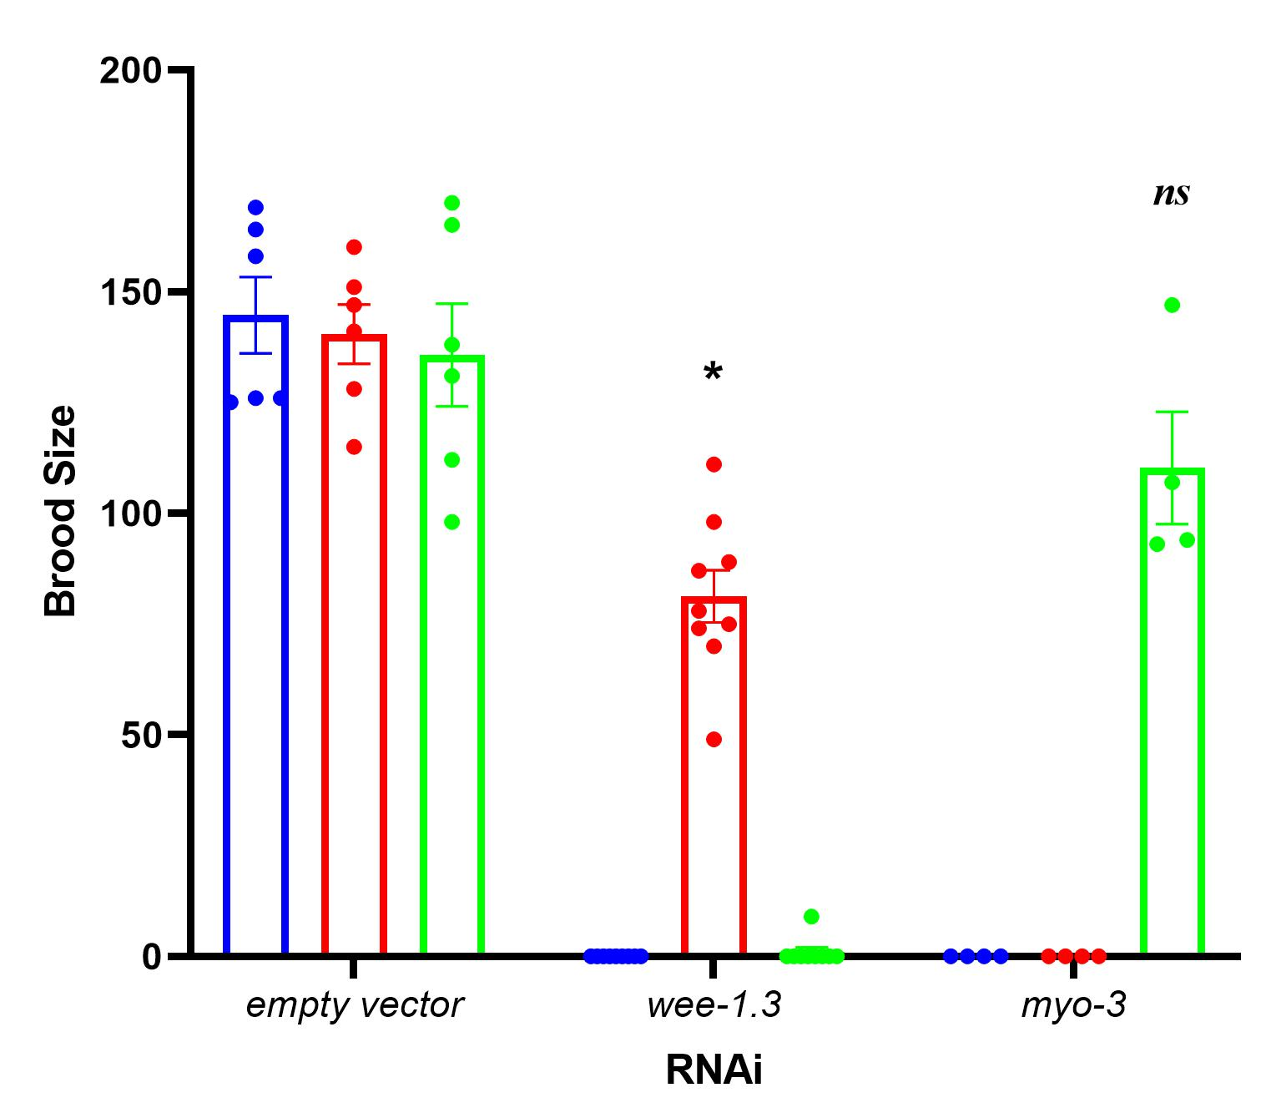
N2: somatic and germline
NL3511: somatic
DCL569: germline
*: significant difference negative control
ns: non significant difference negative control

Slide 15
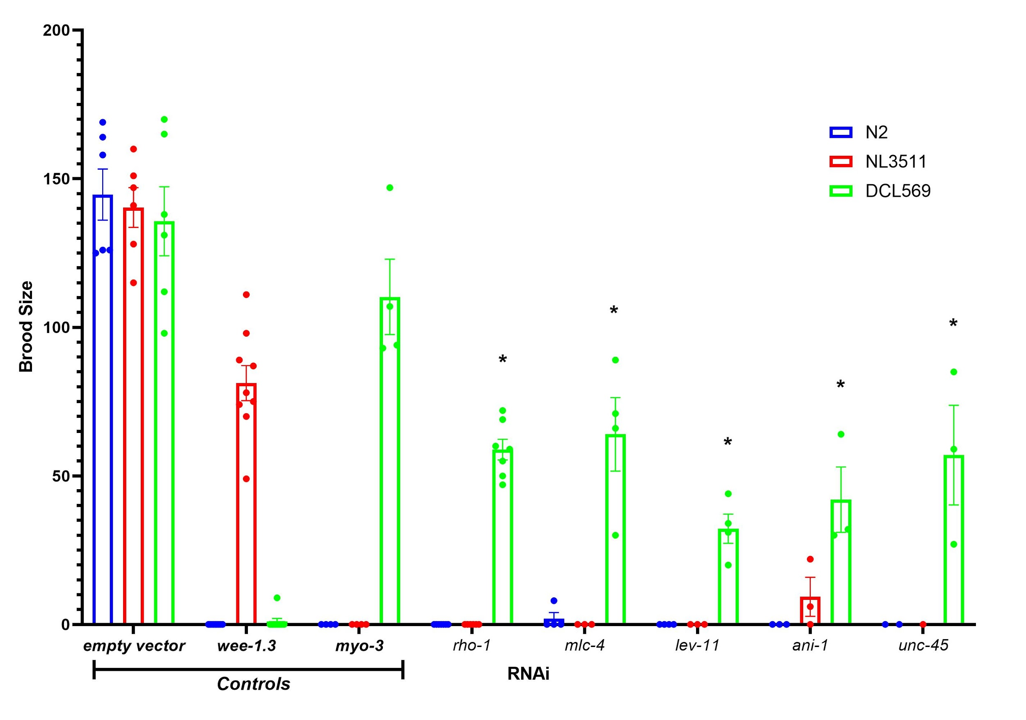
ani-1, lev-11,mlc-4, rho-1, unc-45
N2: somatic and germline
NL3511: somatic
DCL569: germline
*: significant difference negative control
ns: non significant difference negative control

Slide 16
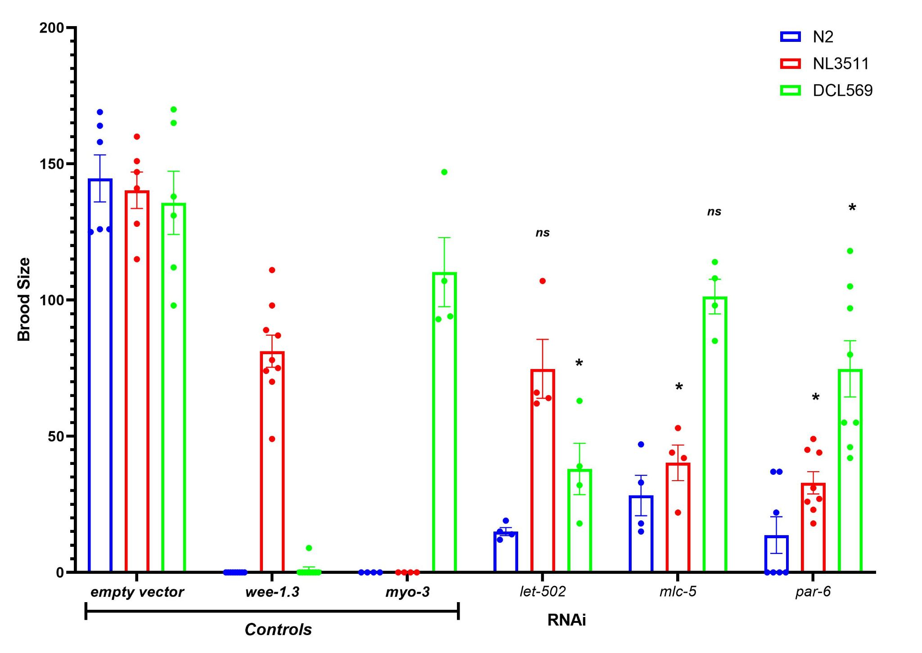
mlc-5, par-6;
let-502
N2: somatic and germline
NL3511: somatic
DCL569: germline
*: significant difference negative control
ns: non significant difference negative control

Slide 17
DISCUSSION

Slide 18
Inhibited gene | Functions in the somatic gonad | Functions in the germline | both the components | Bibliography
myo-3 (C) | Sheath cell contraction, Spermatheca contraction, Vulval muscle |  |  | Ono et al. 2007; Ardizzi and Epstein 1987
mlc-4 | Sheath cell contraction, Spermatheca contraction, Uterine walls activity |  |  | Kovacevic et al. 2013; Shelton et al. 1999
lev-11 | Sheath cell contraction, ? Spermatheca contraction |  |  | Ono et al. 2007
unc-45 | Sheath cell contraction, ? Spermatheca contraction |  |  | Hellerschmied et al. 2019, Ao W, Pilgrim D. 2000
rho-1 | Sheath cell contraction, Spermatheca contraction | Embryo morphogenesis | Cytokinesis | Schonegg 2006, Yoshida et al. 2009, Tan and Zaidel-Bar 2015
? … : suggested function

Slide 19
Inhibited gene | Functions in the somatic gonad | Functions in the germline | Both the components | Bibliography
myo-3 (C) | Sheath cell contraction, Spermatheca contraction, Vulval muscle |  |  | Ono et al. 2007; Ardizzi and Epstein 1987
mlc-5 | ? Sheath cell contraction, ? Spermatheca contraction
par-6 | Distal spermatheca polarization | Polarity establishment in early embryos |  | Aono et al. 2004; Watts et al. 1996
? … : suggested function

Slide 20
Inhibited gene | Functions in the somatic gonad | Functions in the germline | Both the components | Bibliography
myo-3 (C) | Sheath cell contraction, Spermatheca contraction, Vulval muscle |  |  | Ono et al. 2007; Ardizzi and Epstein 1987
wee-1.3 (C) |  | Spermatogenesis | Cell cycle | Lamitina and L’Hernault 2002; Burrows 2006
ani-1 | ??? | Contractile events in early embryos; Extrusion of polar bodies; Maintenance rachis bridges |  | Maddox et al. 2005; Priti et al. 2018
let-502 | ??? | Oocyte cellularization, Maintenance rachis bridges | Cytokinesis | Piekny and Mains 2002; Wissmann et al. 1997

Slide 21
CONCLUSIONS
1- It was possible to pinpoint which of these genes affected more the functioning of the somatic or the germline gonad.
2- ani-1 and let-502 stood out from my experiments. More studies on the role of ani-1 in the sheath cells and spermatheca will be necessary to understand how ani-1 is contributing in these organs. Further studies on the roles of let-502 will be needed to understand the relationship between rho-1-let-502-mlc-4 in the somatic and the germline gonad. This pathway is known to play important roles in actomyosin contractility and it is not obvious why the depletion of each of these three genes does not show the same phenotypic consequences.
3- This project suggests that further studies of other actomyosin regulators in the germline versus the somatic gonad of C. elegans are likely to yield new insights into the actomyosin network functioning, which is conserved between C. elegans and humans.
Thank You for Your attention

